Slide 1


CSE 163
Geospatial Data / Geopandas
Hunter Schafer

Slide 2
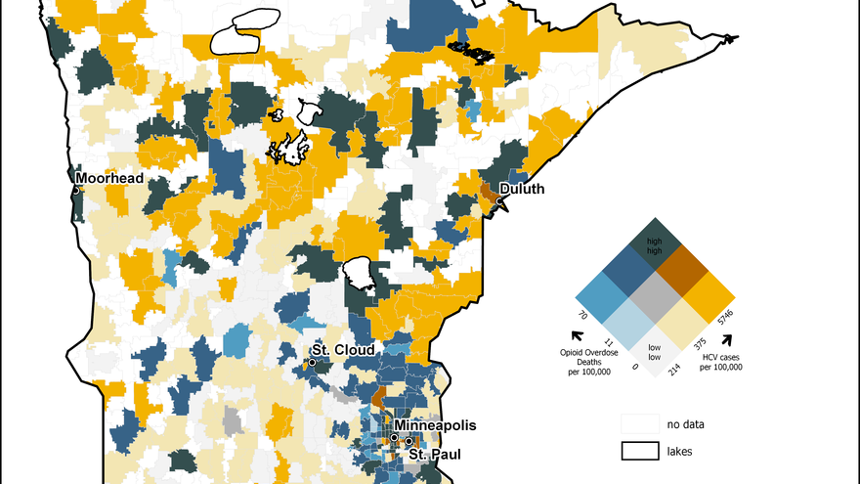
Geospatial Data

Slide 3
Geospatial Data
A lot of data exists in the “real world”
It’s not just a data point, but it’s related to a place or group of people
Geospatial data lets you process your data not only by their values, but also by its location in the world

Slide 4
Geopandas
Exactly like pandas, but with some extra features for geo data
Types
GeoDataFrame
GeoSeries
Many types of files
Shapefile (.shp and friends)
GeoJSON (.json/.geojson)
GeoPackage (.gpkg)
Many more!
data = geopandas.read_file('data_file.shp')

Slide 5
Geopandas
Colab
Read a file containing information about countries in the world
E.g. population, GDP
Make plots to show geospatial relation of GDP or population
Can filter just like a regular DataFrame!

Slide 6
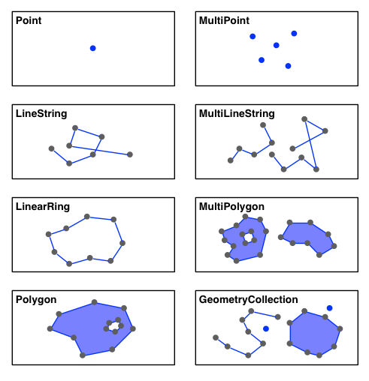
Geometry
One very common notion in geospatial data is a geometry
This is what actually defines the shape of the countries in the last example
Types of geometry: shapely.geometry

Slide 7

Brain Break

Slide 8
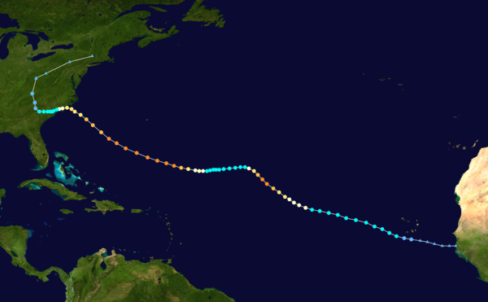
Hurricane Florence
Here’s the trick: This information comes from 2 different datasets!

Slide 9
Florence Example
Colab
Parse data into multiple DataFrames
Plot each dataset over each other

Slide 10
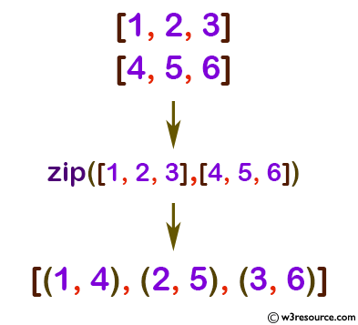
zip
zip is a helpful built-in function to help you combine lists
x = [1,2,3]
y = [4,5,6]
zip(x, y)
Note: zip does not return a list! It returns a generator
Can only access the values by iterating over them
Can only be used once! Iterating “consumes” the series

Slide 11
Matplotlib
Before, we were using a lot of matplotlib stuff blindly
Default plots gets plotted on a global figure (think canvas)
Every time you make a new plot, it will be painted on the same figure, but on a different set of axes
You have to do extra work to get more information on the same plot
fig, ax = plt.subplots(1)
<plot1>(ax=ax)
<plot2>(ax=ax)
fig.show()

